Slide 1


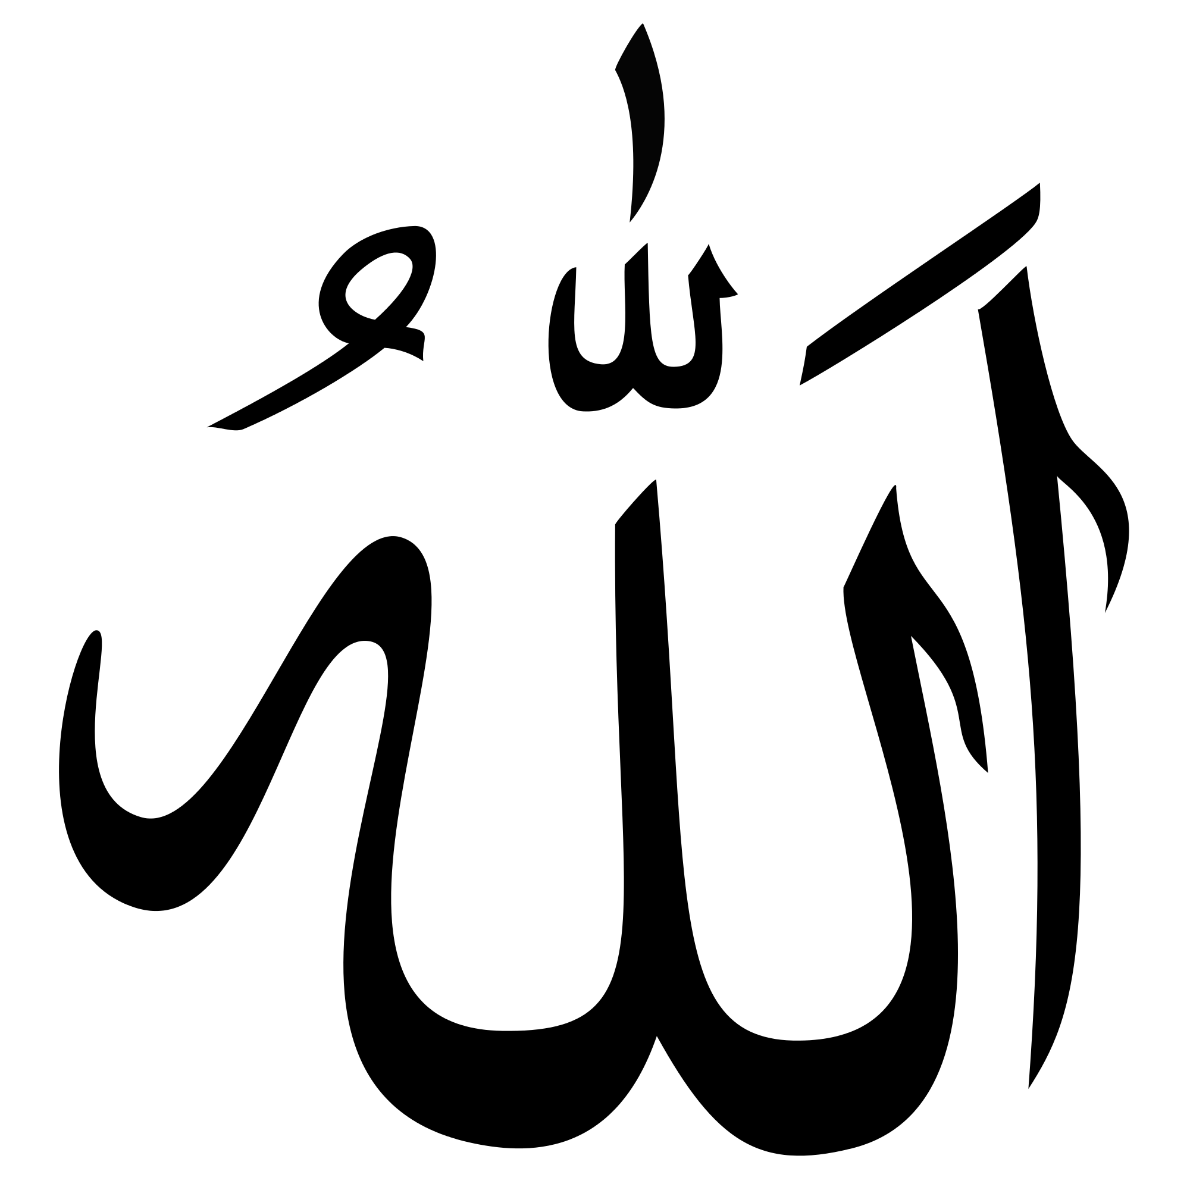
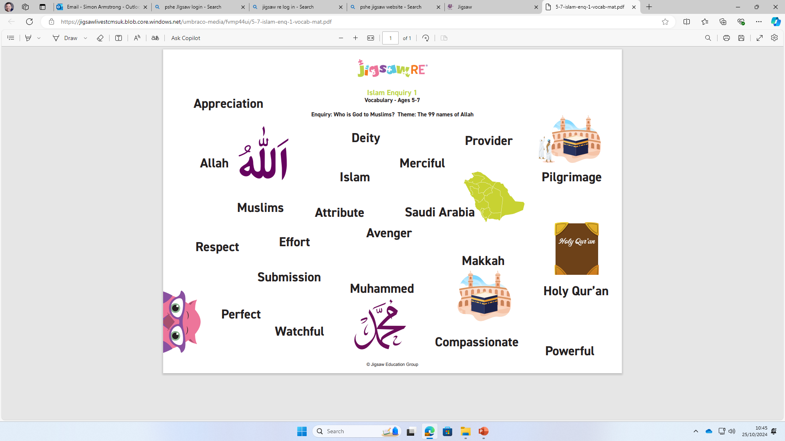
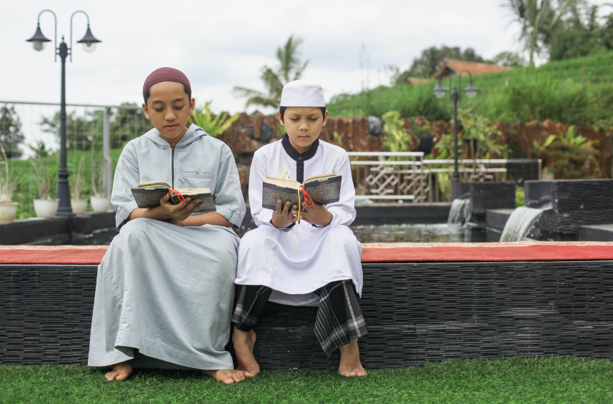
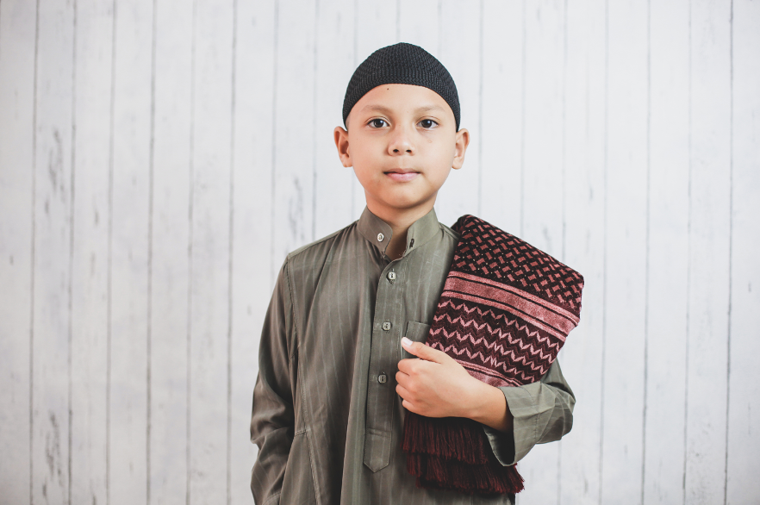
Year 1 | Religious Education | Who is God to Muslims?
Muslims believe that Allah is perfect. He is the one who made human beings, the one who watches them during life and the one who decides what happens when life is over.
Vocabulary
1 | Allah |  | Muslim name for God
2 | Muhammad |  | messenger chosen by Allah
3 | Makkah |  | city where Islam began
4 | Saudi Arabia |  | country Makkah is in
5 | Qur’an |  | The Holy book for Muslims – words of Allah to Muslims
Allah should be the most important thing in a Muslim’s life – for this reason many Muslims do things every day to make sure they remember Allah, like praying 5 times a day.
The prayer times are often at difficult times, but this is to show that Muslims should build their day around Allah rather than fit him into their lives when it suits them best. Allah comes first.

