Slide 1


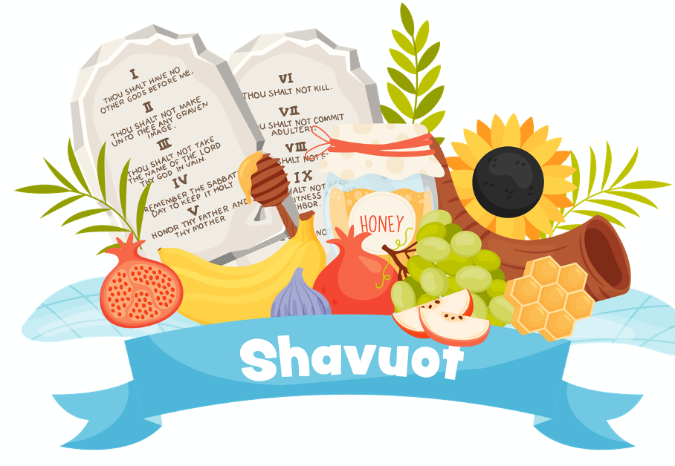
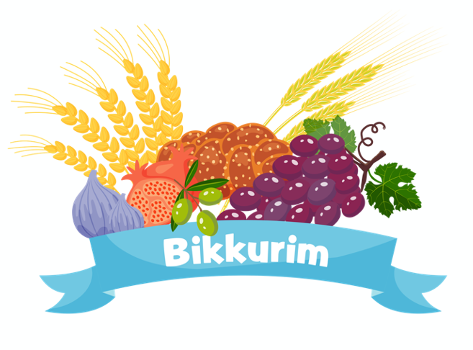
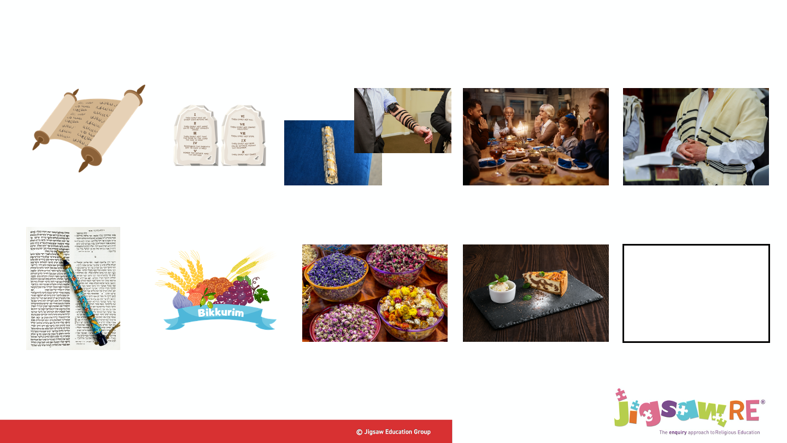
Year 4 | Religious Education | Does celebrating Shavuot make Jewish children feel closer to God?
Shavuot means ‘weeks’ and is also known as the Feast of Weeks. Shavuot has no fixed date and is the least celebrated of all Jewish festivals.
Vocabulary
1 | Shavuot |  | Festival marking the giving of the Torah and 10 Commandments to Moses
2 | Bikkurim |  | Blessing of first wheat and fruits Mezuzah (on the doorposts of Jewish homes) and the tefillin (boxes worn on the hands and head by some Jews) contain a scroll with Hebrew writing
3 | Shema |  | The main Jewish prayer also given to Moses with the Torah : Hear, O Israel, the Lord is our God, the Lord is One
Many years ago, Jewish people would harvest their first wheat and fruits. These would be taken to the Temple in a special basket to be blessed. This ritual is called Bikkurim.
Prayer is an important part of the Shavuot celebration, especially the Shema. This is found in Deuteronomy 6: 4-9
Shavuot is the only time Jews might desire to study all night. This is known as Tikkun.

