Slide 1




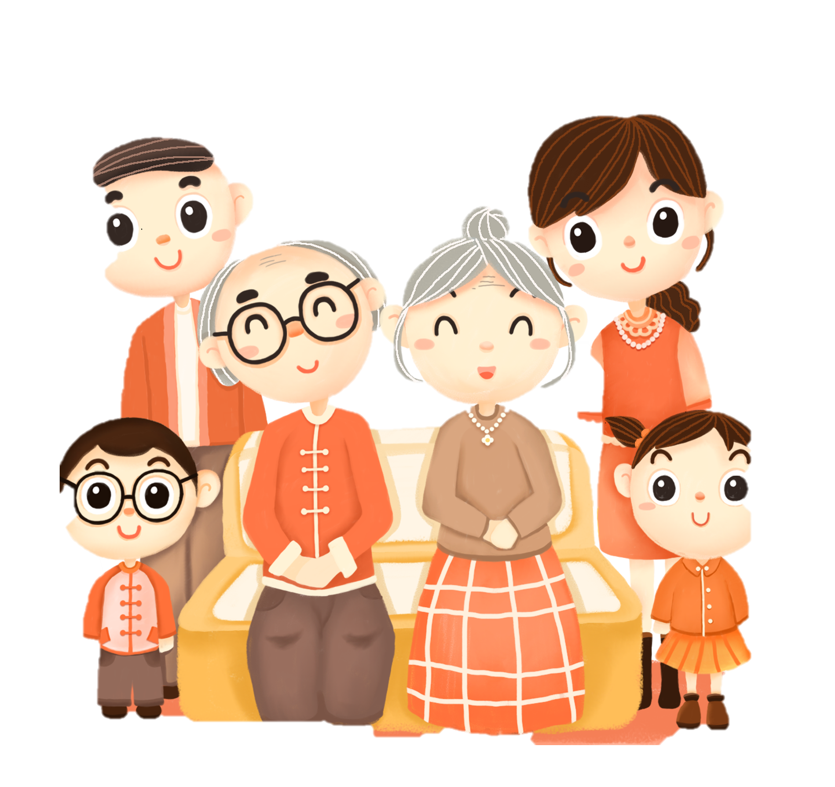
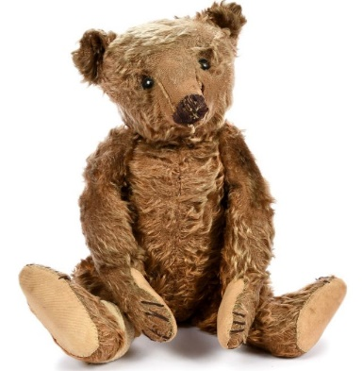
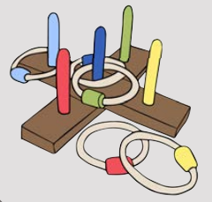
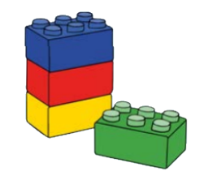
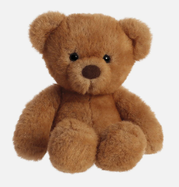
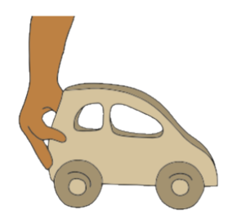
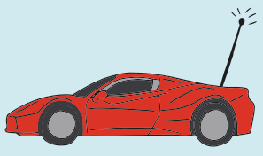
Year 1 | Autumn 2 | History – Toys
The Past
Now
beyond living memory
Living memory
Toys
 | old toys | new toys
1 | made from wood or metal | made from plastic
2 | moved by hand | use batteries to move, light up or make noise
Teddy Bears
 | past | present
1
2 | Looks like a real bear Stiff fur | Different colours and sizes Fluffy fur
Vocabulary
1 | past | Something that has happened.
2 | present | Something that is happening now.
3 | living memory | A time remembered by people who are alive.
4 | old | From the past

