Slide 1






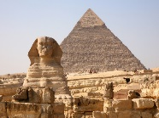
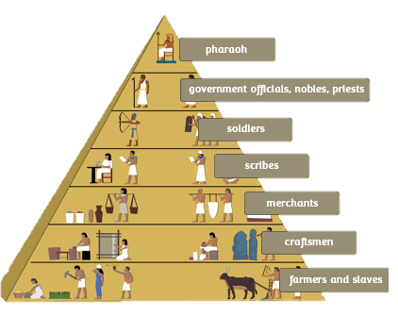
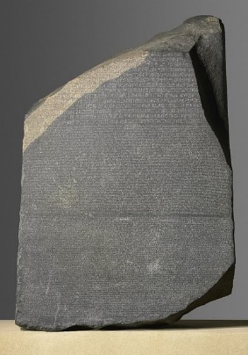
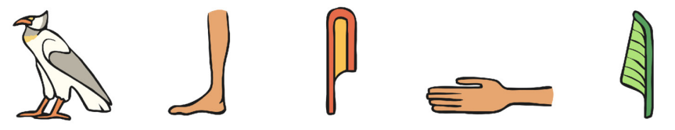

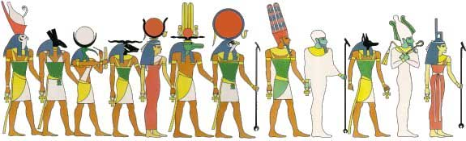
Year 4 | Spring | History – Ancient Egypt
Year 4 | Spring | History – Ancient Egypt
Timeline
Vocabulary
chronology | the order of events in time
society | Community of people
hierarchy | picture of an object representing a word, syllable, or sound, as found in ancient Egyptian.
Great Pyramid and Sphinx built
2500BCE
End of Ancient Egypt
empire
30 BCE
2000 BCE
332BCE
Alexander
the Great invades
Religion
Ancient Egyptians worshipped many gods (polytheistic)
They often had a human body and the head of an animal chosen to represent their powers.
Name | God of…
Ra | Sun
Bastet | Protector of lower Egypt
Sekhmet | Warrior, healing
Structure of society
Communication
1 | Rosetta Stone | helped decode hieroglyphs 3 translations on the stone - Ancient Greek, demotic and hieroglyphics
2 | Hieroglyphs | formal style of writing Symbols instead of letters over 700 different signs
3 | Scribes | educated people who could read and write Kept records of events
Hierarchy

Slide 2
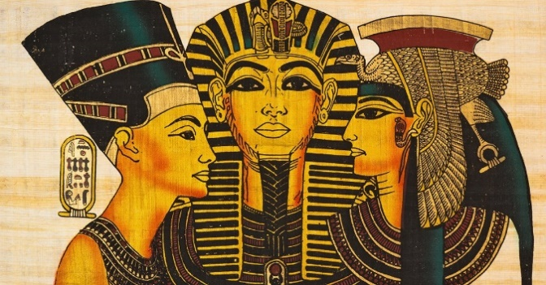
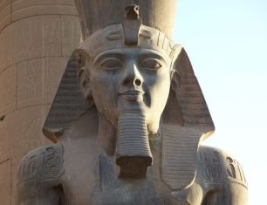
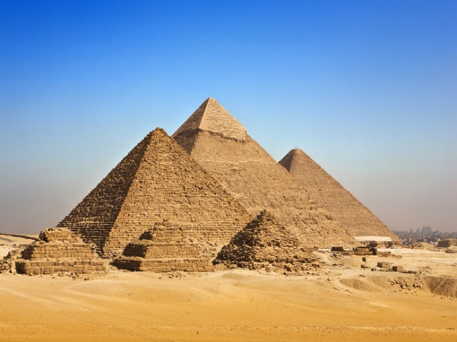
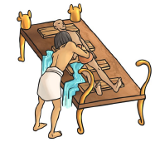
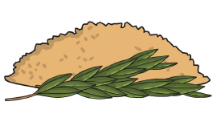
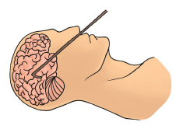
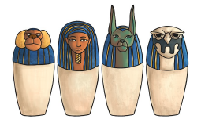
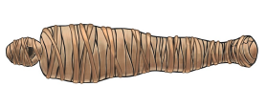
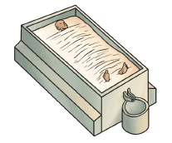
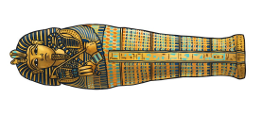
Year 4 | Spring | History – Ancient Egypt
Year 4 | Spring | History – Ancient Egypt
Invasion
Egypt was unified around 3100BCE and built an army
King Ramses II led the Egyptian army in battle and expanded the empire.
Battle of Kadesh, fought by King Rameses II is the oldest recorded battle in history.
Pharaohs
1 | King or Queen of Ancient Egypt
2 | Ancient Egyptians believed the Pharaohs were gods
3 | Pharaohs were mummified when they died.
Pyramids
1 | They were built to protect the Pharaoh’s body and belongings for the afterlife.
2 | Nobody knows how they were built.
3 | Pharaoh Khufu built the Great Pyramid at Giza.
Vocabulary
1 | Afterlife | Life after death | 2 | mummification | the process of preparing the body for the afterlife
3 | Amulet | a protective charm | 4 | sarcophagus | a coffin
Mummification Process
1 | body is washed and purified |  | 4 | body is stuffed with sawdust and linen soaked in oils
2 | all organs (except heart) removed. placed in canopic jars |  | 5 | body wrapped in linen jewels and amulets included
3 | body placed in bath of natron (salt) and left for 40 days |  | 6 | death mask placed over face or portrait painted on body put in a sarcophagus

