Slide 1



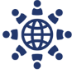
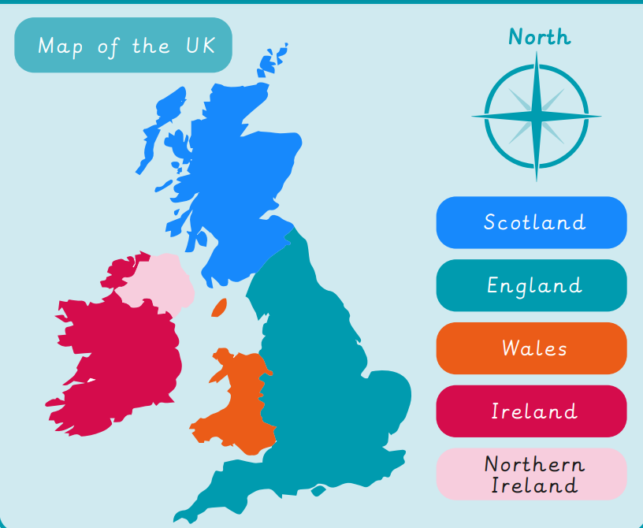
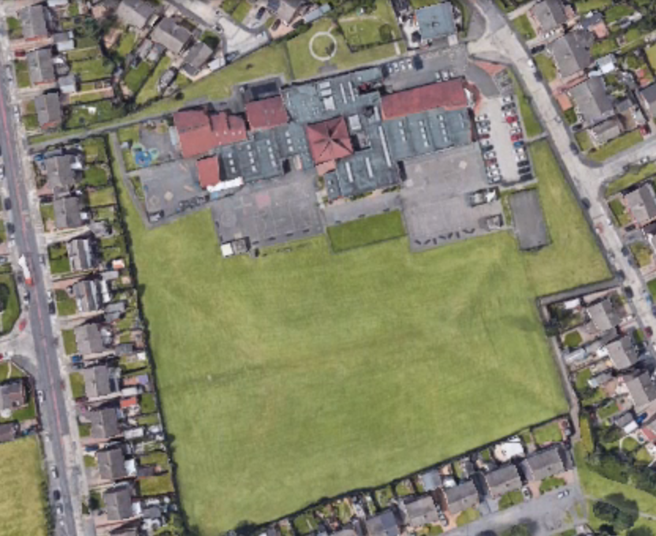
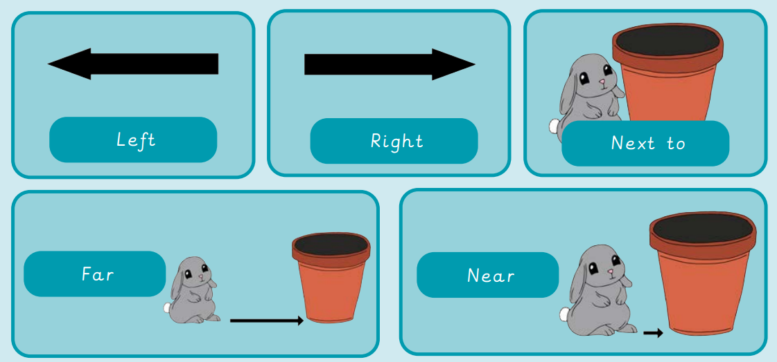

Year 1 | Autumn 1 | Geography – What is it like here?
The United Kingdom
1 | Which country do we live in? | England
Aerial View
1 | Aerial View | A view from the air
Vocabulary
1 | location | where something is
2 | country | a land with its own government
3 | town | Middlesbrough is a town.
4 | house | a building to live in
5 | map | a picture of a place, drawn from above
6 | globe | a round map of Earth
7 | features | important objects on a map
8 | symbols | a mark that shows a feature
9 | key | a list that explains the symbols
Directions
1 | 2 | 3 | 4 | 5
Left | Right | Next to | Far | Near

Slide 2

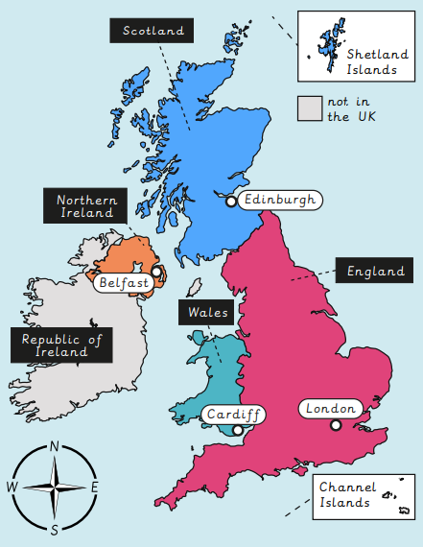
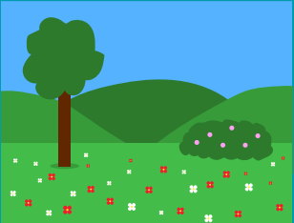
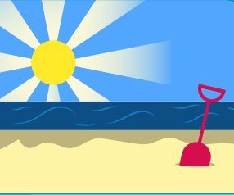
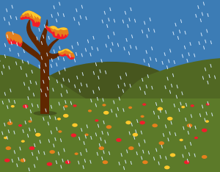
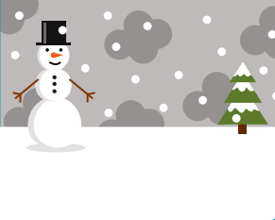



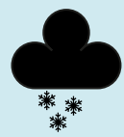



Year 1 | Spring 1 | Geography – What is the weather like in the UK?
The United Kingdom
1 | Which country do we live in? | England
Seasons in the UK
1 | seasons | a part of the year when the weather changes
2 | Spring |  | 3 | Summer
4 | Autumn |  | 5 | Winter
Vocabulary
1 | atlas | a book of maps
2 | country | a land with its own government
3 | capital city | where the country’s government is
4 | temperature | how hot or cold something or somewhere is
5 | climate | long-term weather in one place
6 | compass | a tool to find direction
7 | weather | short-term conditions in one place
Weather
1 | 2 | 3 | 4 | 5 | 6 | 7
sunny | sunny and cloudy | rain | snow | thunder and lightning | cloudy | windy

Slide 3
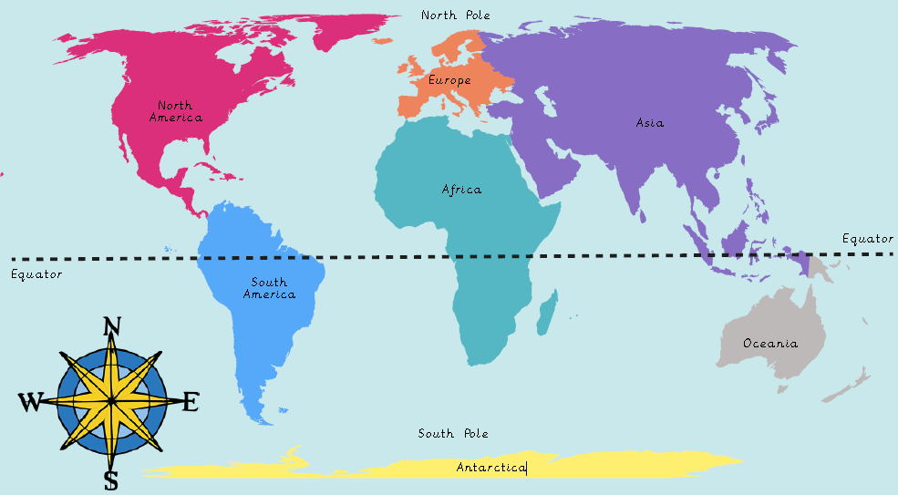
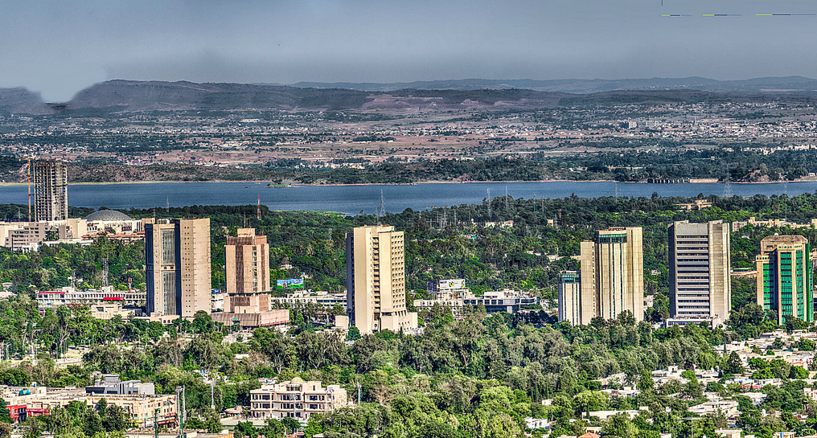
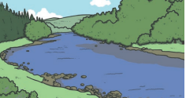
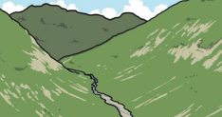
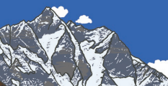
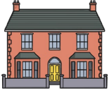

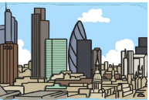
Year 1 | Summer 1 | Geography – What is it like to live in Islamabad, Pakistan?
World Map
Which country is Islamabad in? | Pakistan
Which continent is Pakistan in? | Asia
Islamabad
mountain
houses
Pakistan
river
office
Physical features of Pakistan
feature that occurs naturally on Earth
river | valley | mountain
Human features of Pakistan
a feature made by people
house | road | City (Islamabad)

