Slide 1


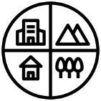


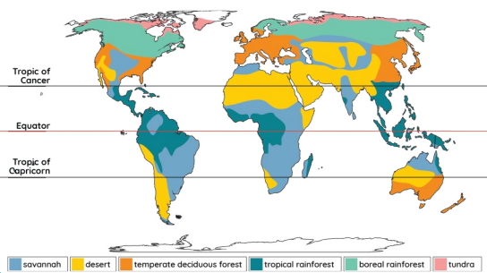
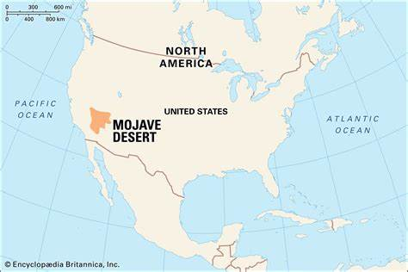
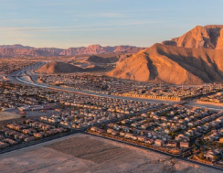
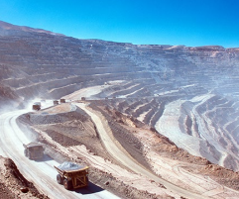
Year 5 | Autumn 2 | Geography – Would you like to live in a desert?
Biomes of the world
Vocabulary
biome | an area of the world with a similar climate and landscape, where similar plants and animals live
desert | any stretch of land with little to no rainfall and extremely sparse vegetation and wildlife
vegetation | all the plants that grow in a certain area
climate | long-term weather conditions in a specific region.
Mojave Desert
The Mojave Desert is in North America in the United States.
It is within the states of California, Nevada, Utah and Arizona.
It is a hot desert biome. It is dry and arid although temperatures can drop at night and there can be the occasional downpour.
Vocabulary
1 | vegetation belt
 | an area where certain plants grow because of its climate
2 | arid
 | too little rain to support lots of vegetation.
3 | mining
 | the process of digging up valuable minerals from the Earth’s crust
4 | ranching
 | keeping animals on a large farm particularly in the Americas
5 | renewable energy
 | energy generated from a continuous source such as wind or water
Uses of the Mojave Desert
Living in settlements Recreational purposes like hiking or quad biking Ranching and farming Generating renewable energy Mining precious minerals Protecting areas of natural beauty in national parks

Slide 2
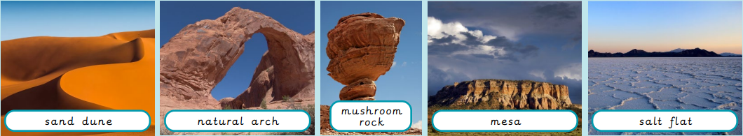
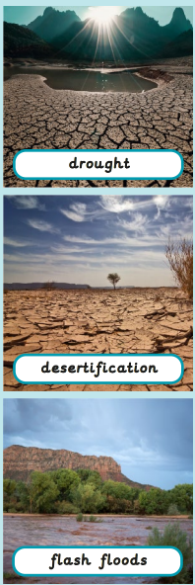
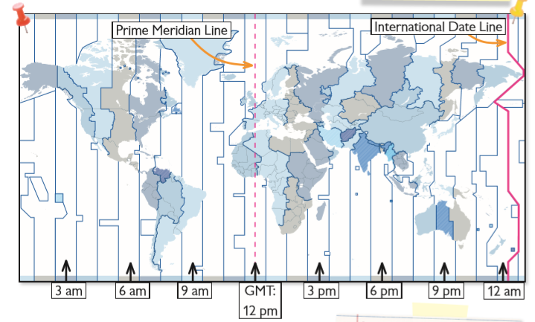
Year 5 | Autumn 2 | Geography – Would you like to live in a desert?
Physical features in the Mojave Desert
a hill made of sand | an arch shape made of rock | a rock in a shape similar to a mushroom | a mountain with steep sides and a flat top | a flat area of land covered in salt, caused by evaporation
Threats to the desert
Time zones
 | time zone | different areas that use the same time
 | Prime Meridian | the line of zero degrees longitude that defines all time zones
 | lines of longitude | invisible vertical lines mapped on the globe to show how far east or west a place is from the Prime/Greenwich Meridian
Vocabulary
1 | drought
 | a long period of time without rain in which living things begin to suffer
2 | desertification
 | when land turns into desert
3 | flash flood
 | a sudden large flood caused by heavy rain

Slide 3

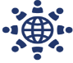
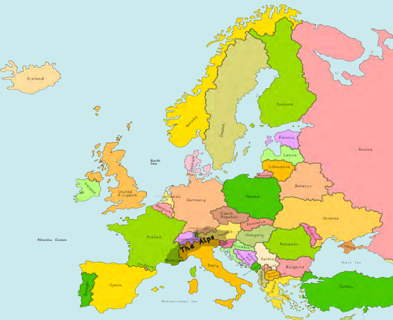
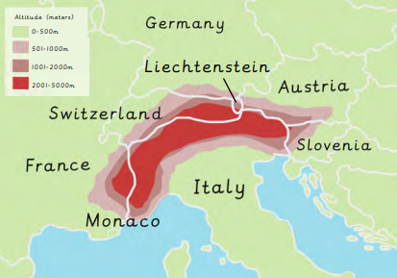
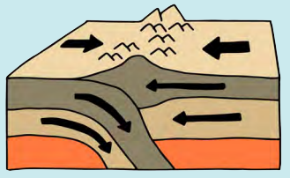
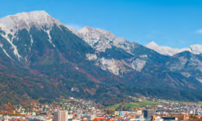
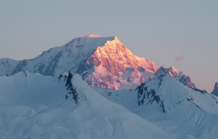
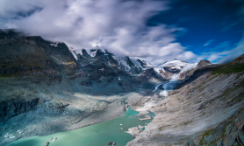
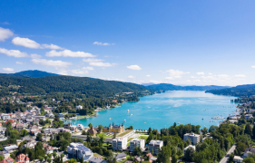
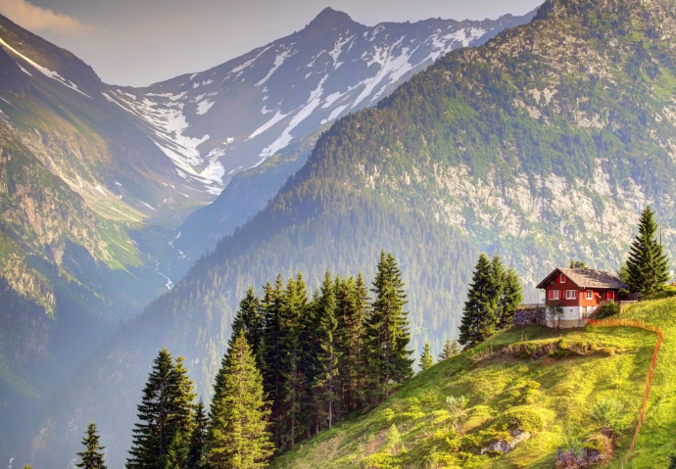
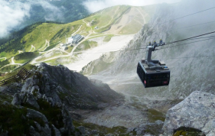
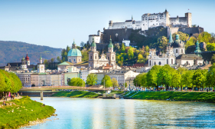
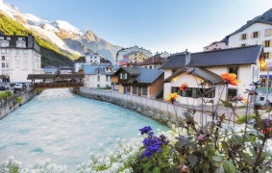
Year 5 | Summer 1 | Geography - What is life like in the Alps?
What is a mountain?
A landform that rises at least 1,000ft (300m) above its surrounding area.
Where are the Alps located?
Map of Europe
Fold mountains
 | The Alps are fold mountains. They were formed when two tectonic plates were pushed together and the ground was forced upwards.
Climate
 | Most of the Alps have a mountain climate. It is much colder than the surrounding climate due to the height of the mountains. Lower regions of the Alps have a temperate climate.
Countries where the Alps are located
What features are found in the Alps?
Physical features
 | Mont Blanc (highest mountain in the Alps) |  | Pasterze Glacier |  | Lake Worthersee
Human features
 | Nordkette cable car |  | Hohensalz-burg Fortress |  | Chamonix (ski resort)
Biomes
 | The Alps are a temperate forest biome. There are deciduous forests on the valley floors and coniferous forests with less vegetation at higher elevations.

Slide 4
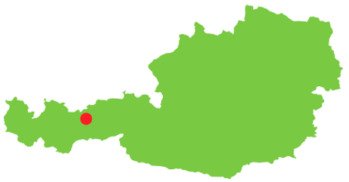
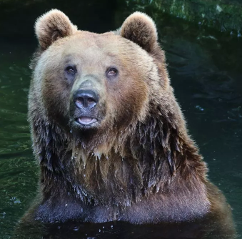
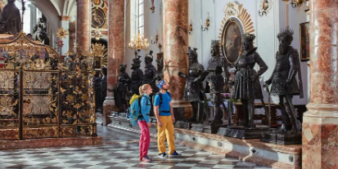
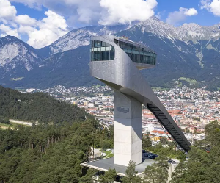
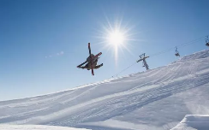
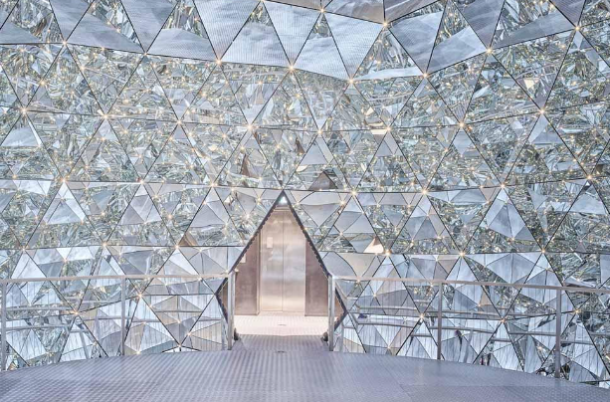
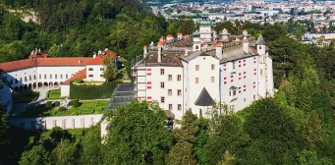


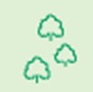
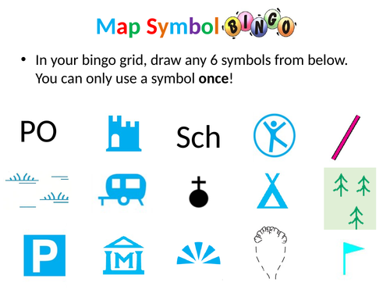



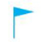
Year 5 | Summer 1 | Geography – What is life like in the Alps?
Where is Innsbruck located?
Continent | Europe
Country | Austria
What recreational activities are there is Innsbruck?
 | The Alpine Zoo |  | The Court Church (tomb and bronze statues) |  | Bergisel Ski Jump
 | Nordkette |  | Swarovski Crystal Worlds |  | Ambras Castle (the oldest museum in the world)
Innsbruck
OS map symbols
 | building / important building |  | recreational route
 | non-coniferous trees |  | school
 | water |  | place of worship
 | traffic-free cycle route |  | main road
 | golf course or links |  | secondary road
Vocabulary
1 | tectonic plates | Large moving pieces of solid rock on the Earth’s surface
2 | climate | Long-term weather conditions in a specific region
3 | glacier | A slow-moving mass of ice formed by the accumulation of compact snow on mountains
4 | temperate climate | A region with mild temperatures (warm summers and cold winters)
5 | coniferous forests | Trees that do not shed their leaves in autumn and winter
6 | deciduous forests | Trees that shed their leaves in autumn and winter
7 | vegetation | All the plants that grow in a certain area
8 | recreational | Land use that provides leisure activities
9 | tourist | A person who travels to a place for pleasure
10 | tourism | Travel for pleasure in which people visit places of interest

Slide 5
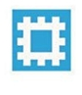
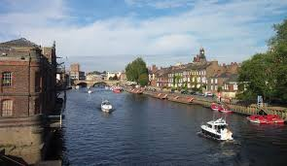
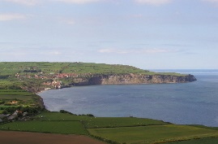
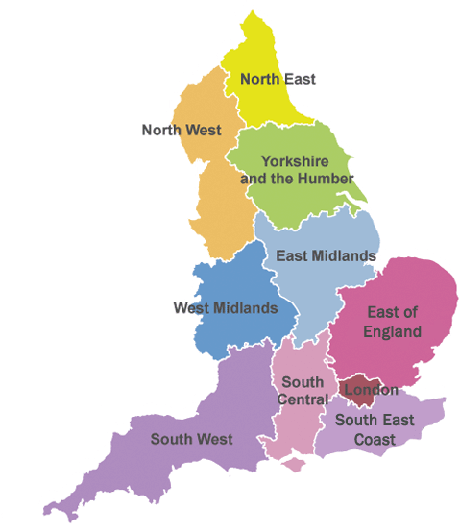

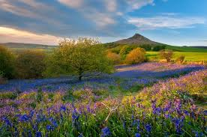

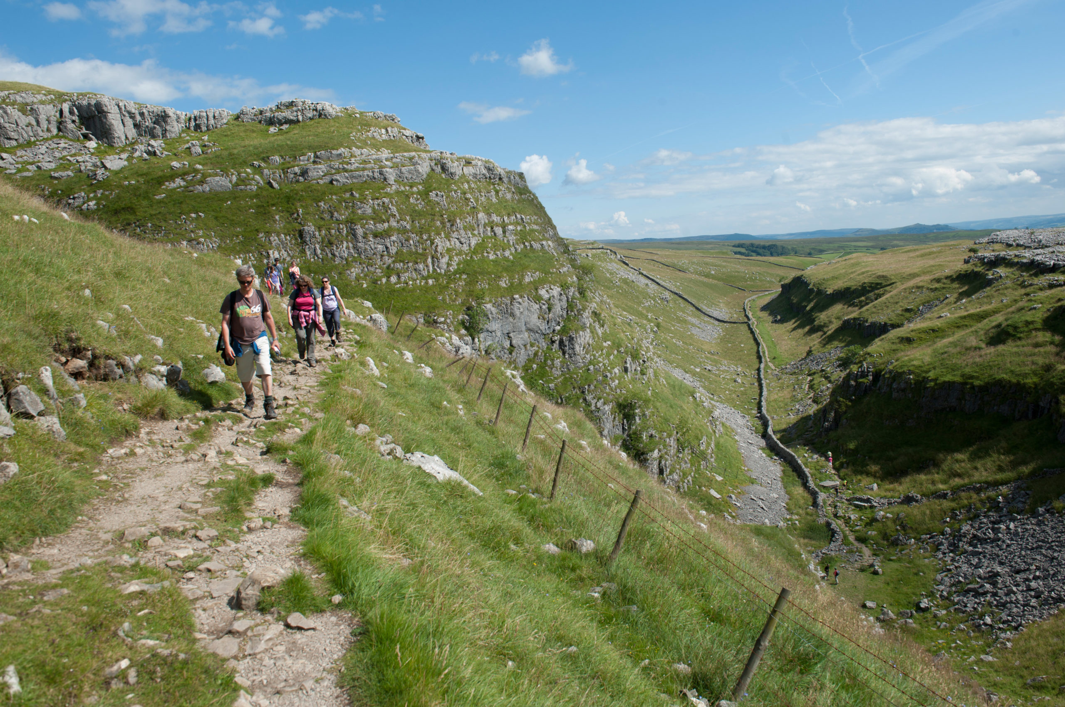

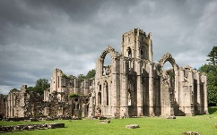
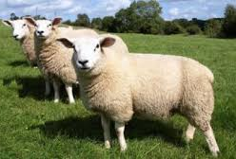
Year 5 | Summer 2 | Geography – What are the similarities and differences between Yorkshire and the Humber and Brandenburg?
Yorkshire and the Humber
1 | Continent and country | Europe, England
2 | Major cities | Leeds, York, Bradford
3 | Time zone | GMT
4 | Climate | Temperate
OS Symbols
1 | English Heritage
2 | Museum
3 | Lighthouse
4 | Recreation, leisure or sports centre
5 | Youth hostel
6 | Singletrack railway
Physical Geography
Landforms created by Earth
1 | Rivers | River Ouse River Trent
2 | Coastline | Runs from River Tees to Humber Estuary
3 | National parks | North York Moors Yorkshire Dales
4 | Mountain range | The Pennines
Human Geography
How humans have changed and affected the land
1 | Landmarks | York Minster Ribblehead Viaduct Humber Bridge Whitby Abbey
2 | Economy | Agriculture (livestock) Tourism
3 | Art & culture | Museums Heritage sites
Vocabulary
1 | Economy | How money is made and used in a country or region
2 | Agriculture | Growing crops or keeping animals for food and materials
3 | National park | A protected area of land
4 | Culture | A ‘way of life’ – how people do things
5 | Heritage site | A place of historical importance
Notes:
ADD OS symbols to the KO.

Slide 6
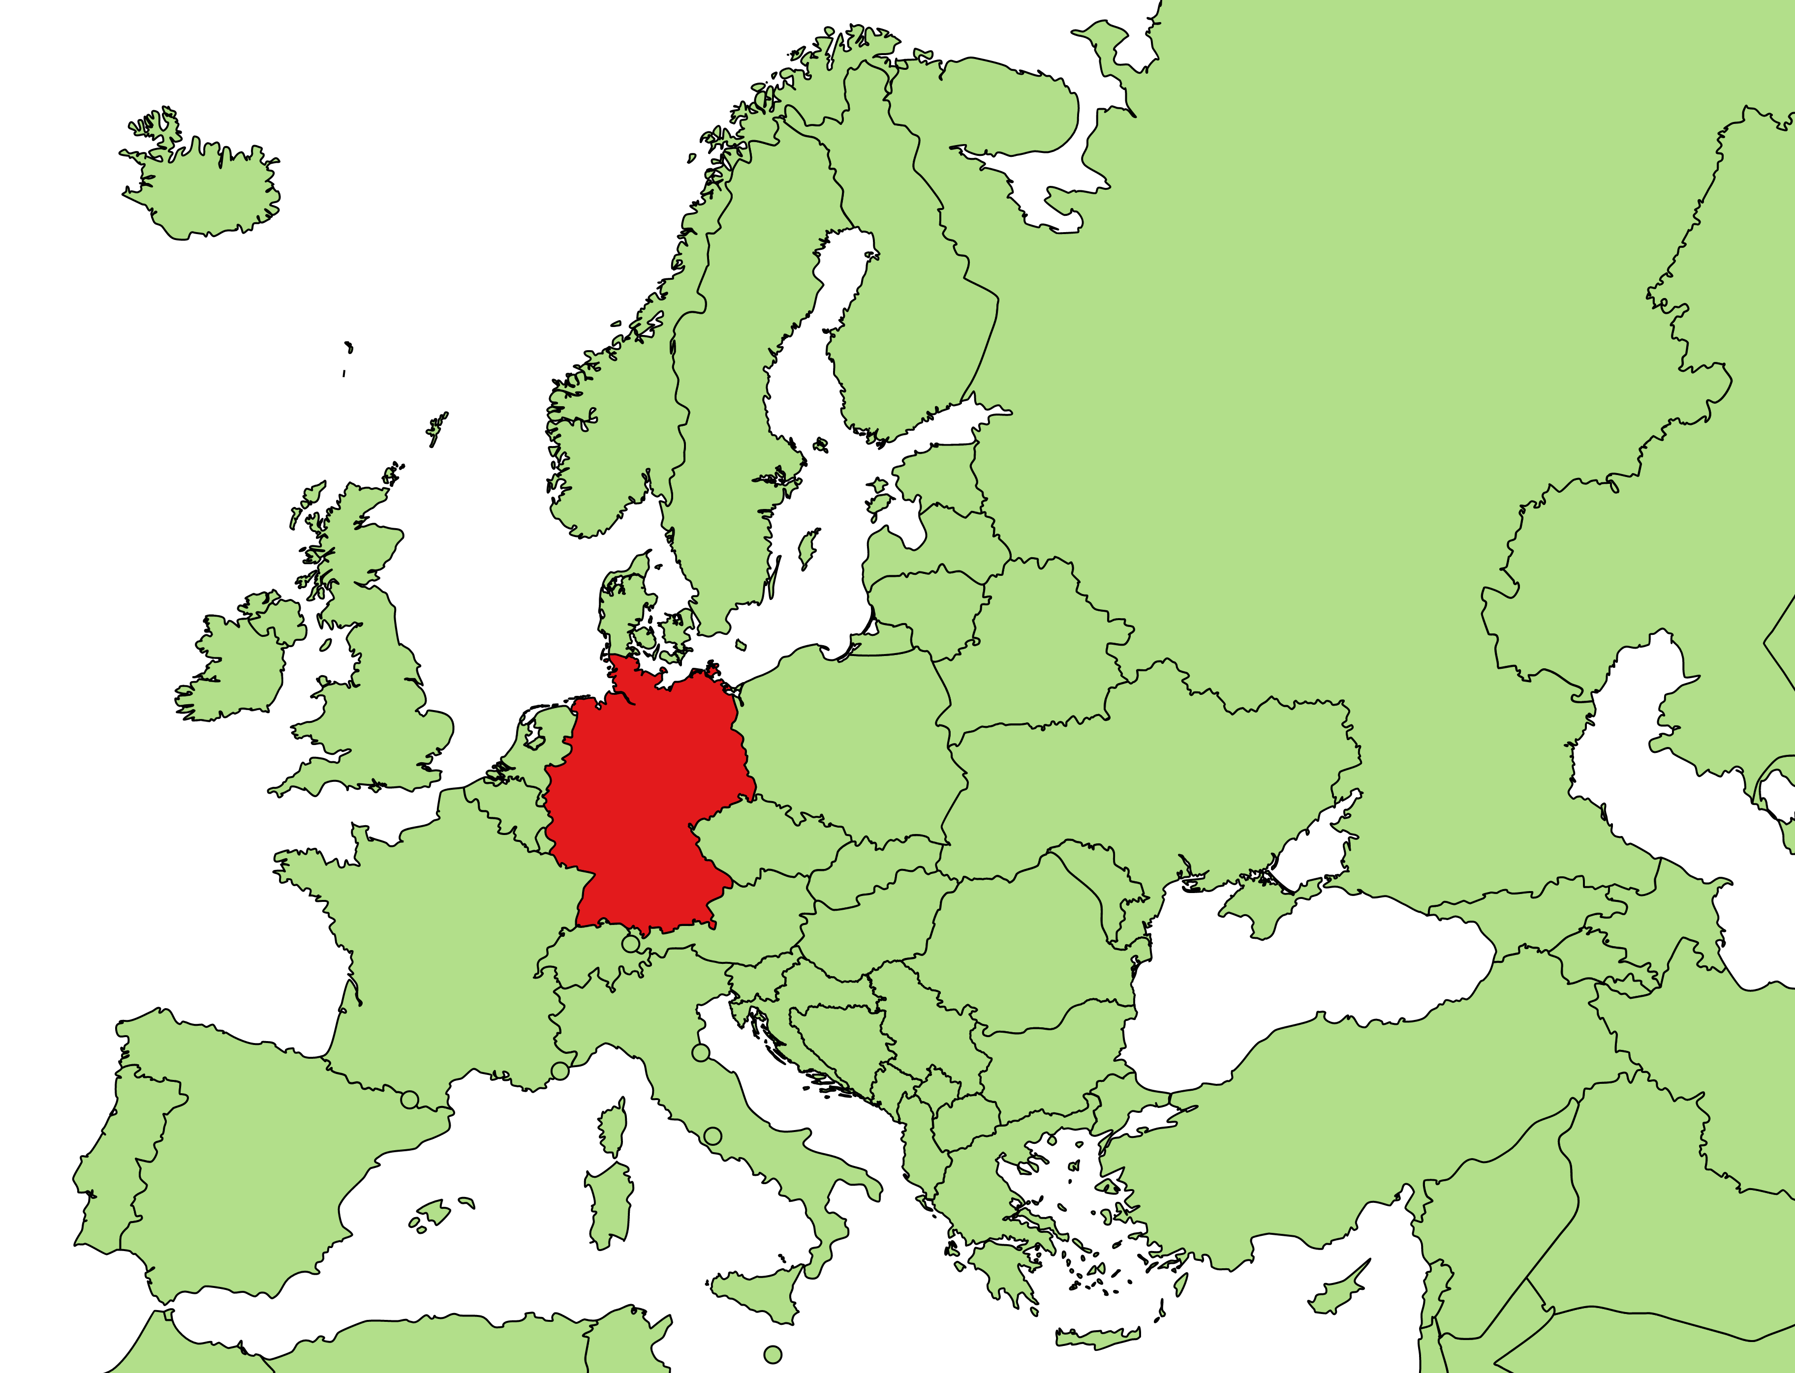
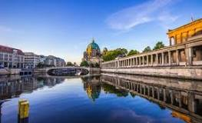
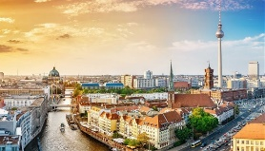
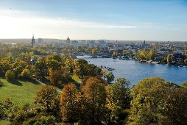
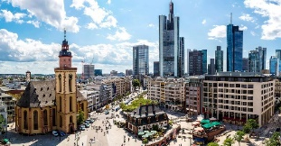
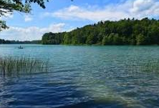
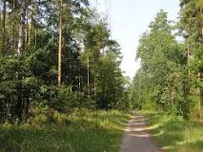
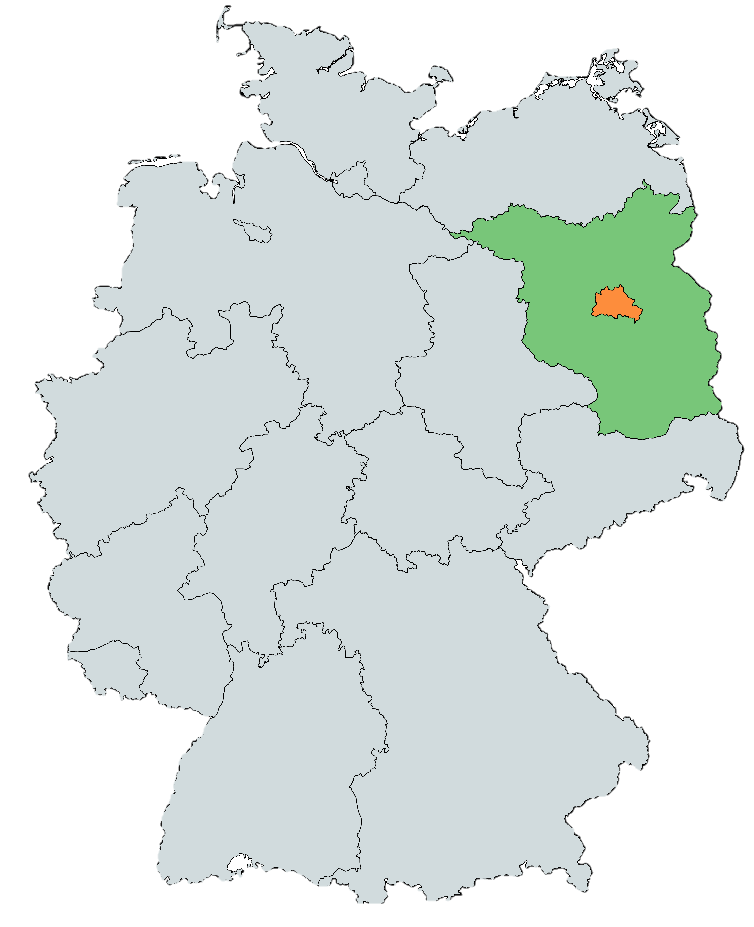
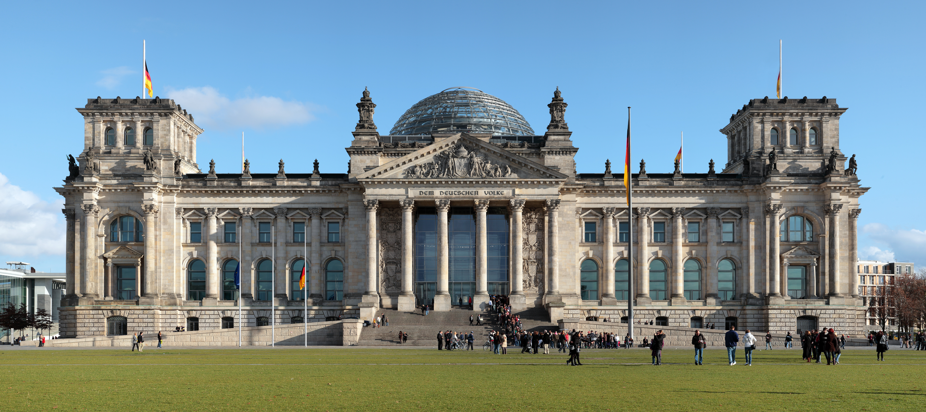
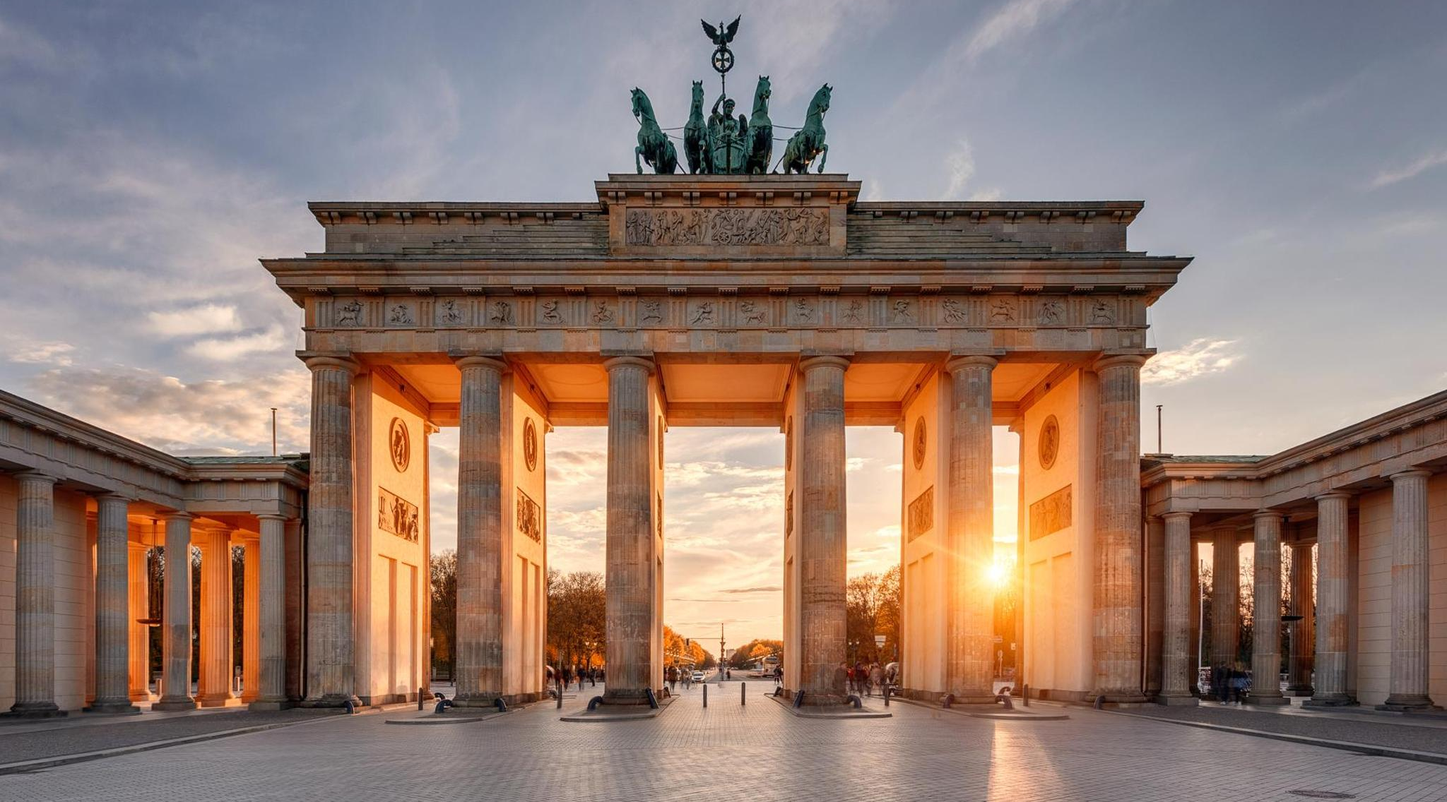
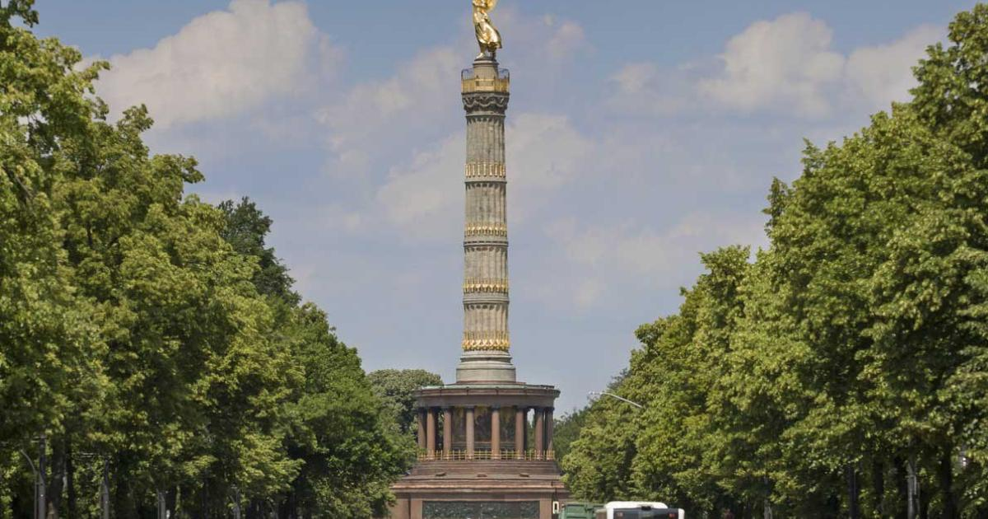
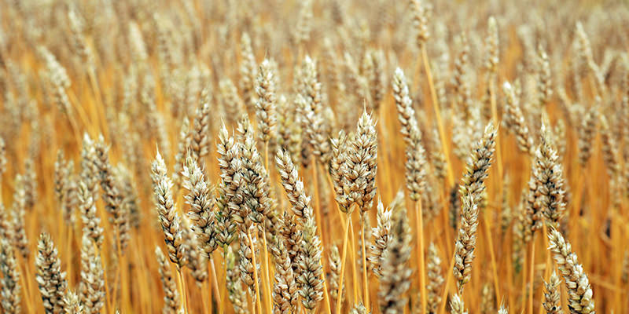




Year 5 | Summer 2 | Geography – What are the similarities and differences between Yorkshire and the Humber and Brandenburg?
Germany
1 | Continent | Europe
2 | Capital city | Berlin
3 | Time Zone | GMT +2
4 | Climate | Temperate
Major Cities in Brandenburg
1 | 2 | 3
Berlin | Potsdam | Frankfurt
Physical Geography
Landforms created by Earth
1 | Rivers | River Spree
2 | Lakes | Lake Over 3,000 lakes
3 | Forests | Pine tree forests
Vocabulary
1 | GMT | Greenwich Mean Time – the time in London
2 | Population | The number of inhabitants in a particular place
3 | Tourism | holidays and visits to places of interest
Brandenburg
1 | population | 6.3 million
Human Geography
How humans have changed and affected the land.
1 | Landmarks | Reichstag building Brandenburg Gate Berlin Victory Column
2 | Economy | Agriculture (crops) Tourism
3 | Art & culture | East Side Gallery Holocaust Memorial
Brandenburg
Berlin

